Slide 1
ΔΙΑΣΗΜΕΣ ΕΤΑΙΡΙΕΣ ΚΑΙ ΔΙΑΣΗΜΟΙ ΠΟΥ ΕΧΟΥΝ ΣΠΟΝΣΟΡΑΡΕΙ
Κωνσταντίνος Μιχαλόπουλος
Βπ 2019-2020

Slide 2
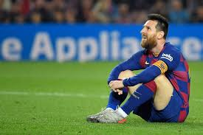
ADIDAS-LIONEL MESSI(1/3)
Lionel Andrés Messi Cuccittini (born 24 June 1987) is an Argentine professional footballer who plays as a forward and captains both Spanish club Barcelona and the Argentina national team. Often considered the best player in the world and widely regarded as one of the greatest players of all time, Messi has won a record six Ballon d'Or awards, and a record six European Golden Shoes. He has spent his entire professional career with Barcelona, where he has won a club-record 34 trophies, including ten La Liga titles, four UEFA Champions League titles and six Copas del Rey. A prolific goalscorer and a creative playmaker, Messi holds the records for most goals in La Liga (433), a La Liga and European league season (50), most hat-tricks in La Liga (35) and the UEFA Champions League (8), and most assists in La Liga (181) and the Copa América (13). He has scored over 700 senior career goals for club and country

Slide 3
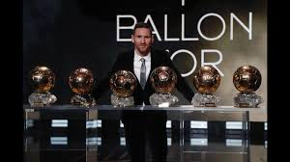
LIONEL MESSI(2/3)
Born and raised in central Argentina, Messi relocated to Spain to join Barcelona at age 13, for whom he made his competitive debut aged 17 in October 2004. He established himself as an integral player for the club within the next three years, and in his first uninterrupted season in 2008–09 he helped Barcelona achieve the first treble in Spanish football; that year, aged 22, Messi won his first Ballon d'Or. Three successful seasons followed, with Messi winning three consecutive Ballons d'Or, including an unprecedented fourth. During the 2011–12 season, he set the La Liga and European records for most goals scored in a single season, while establishing himself as Barcelona's all-time top scorer. The following two seasons, Messi finished second for the Ballon d'Or behind Cristiano Ronaldo—his perceived career rival—before regaining his best form during the 2014–15 campaign, becoming the all-time top scorer in La Liga and leading Barcelona to a historic second treble, after which he was awarded a fifth Ballon d'Or in 2015. Messi assumed the captaincy of Barcelona in 2018, and in 2019 he secured a record sixth Ballon d'Or.

Slide 4
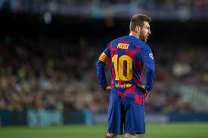
LIONEL MESSI (3/3)
An Argentine international, Messi is his country's all-time leading goalscorer. At youth level, he won the 2005 FIFA World Youth Championship, finishing the tournament with both the Golden Ball and Golden Shoe, and an Olympic gold medal at the 2008 Summer Olympics. His style of play as a diminutive, left-footed dribbler drew comparisons with his compatriot Diego Maradona, who described Messi as his successor. After his senior debut in August 2005, Messi became the youngest Argentine to play and score in a FIFA World Cup during the 2006 edition, and reached the final of the 2007 Copa América, where he was named young player of the tournament. As the squad's captain from August 2011, he led Argentina to three consecutive finals: the 2014 FIFA World Cup, for which he won the Golden Ball, and the 2015 and 2016 Copas América. After announcing his international retirement in 2016, he reversed his decision and led his country to qualification for the 2018 FIFA World Cup, and a third-place finish at the 2019 Copa América.One of the most famous athletes in the world, Messi has been sponsored by sportswear company Adidas since 2006 and has established himself as their leading brand endorser. According to France Football, Messi was the world's highest-paid footballer for five years out of six between 2009 and 2014, and was ranked the world's highest-paid athlete by Forbes in 2019. He was among Time's 100 most influential people in the world in 2011 and 2012.

Slide 5
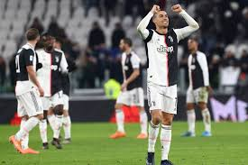
NIKE-CRISTIANO RONALDO(1/3)
Cristiano Ronaldo dos Santos Aveiro(born 5 February 1985) is a Portuguese professional footballer who plays as a forward for Serie A club Juventus and captains the Portugal national team. Often considered the best player in the world and widely regarded as one of the greatest players of all time,Ronaldo has won five Ballons d'Or and four European Golden Shoes, both of which are records for a European player. He has won 29 trophies in his career, including six league titles, five UEFA Champions Leagues, one UEFA European Championship, and one UEFA Nations League. A prolific goalscorer, Ronaldo holds the records for the most goals scored in the UEFA Champions League (128) and the joint-most goals scored in the UEFA European Championship (9). He has scored over 700 senior career goals for club and country.

Slide 6
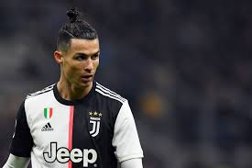
CRISTIANO RONALDO(2/3)
Born and raised in Madeira, Ronaldo began his senior club career playing for Sporting CP, before signing with Manchester United in 2003, aged 18. After winning the FA Cup in his first season, he helped United win three successive Premier League titles, the UEFA Champions League, and the FIFA Club World Cup; at age 23, he won his first Ballon d'Or. In 2009, Ronaldo was the subject of the then-most expensive association football transfer when signed for Real Madrid in a transfer worth €94 million (£80 million). There, Ronaldo won 15 trophies, including two La Liga titles, two Copas del Rey, and four UEFA Champions League titles, and became the club's all-time top goalscorer. After joining Madrid, Ronaldo finished runner-up for the Ballon d'Or three times, behind Lionel Messi—his perceived career rival—before winning back-to-back Ballons d'Or from 2013–2014 and again from 2016–2017. After winning a third consecutive Champions League title in 2018, Ronaldo became the first player to win the trophy five times. In 2018, he signed for Juventus in a transfer worth an initial €100 million (£88 million), the highest ever paid by an Italian club and the highest ever paid for a player over 30 years old. With the Italian outfit, he has won one Serie A and one Supercoppa Italiana.

Slide 7
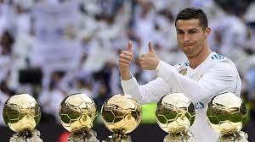
CRISTIANO RONALDO(3/3)
A Portuguese international, Ronaldo was named the best Portuguese player of all time by the Portuguese Football Federation in 2015. He made his senior debut in 2003 at age 18, and has since earned over 160 caps, including appearing and scoring in ten major tournaments, becoming Portugal's most capped player and his country's all-time top goalscorer. He scored his first international goal at Euro 2004 and helped Portugal reach the final of the competition. He assumed full captaincy in July 2008, leading Portugal to their first-ever triumph in a major tournament by winning Euro 2016, and received the Silver Boot as the second-highest goalscorer of the tournament. He became the highest European international goalscorer of all-time in 2018.One of the most marketable athletes in the world, Ronaldo was ranked the world's highest-paid athlete by Forbes in 2016 and 2017 and as the world's most famous athlete by ESPN from 2016 to 2019. Time included him on their list of the 100 most influential people in the world in 2014. As of January 2020, Ronaldo is also the most followed user on Instagram. With earnings of €720 million (£615 million) from 2010 to 2019, he was ranked second in Forbes list of highest-paid athletes of the decade.

Slide 8
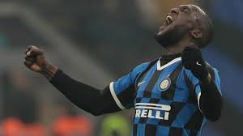
PUMA-ROMELU LUKAKU (1/3)
Romelu Menama Lukaku Bolingoli (born 13 May 1993) is a Belgian professional footballer who plays as a striker for Serie A club Inter Milan and the Belgium national team.

Slide 9
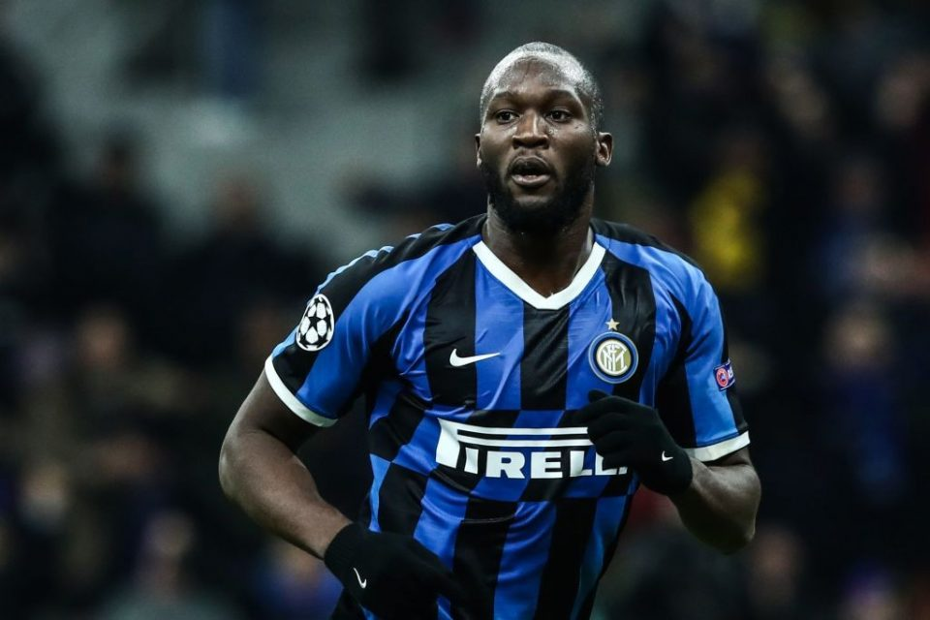
ROMELU LUKAKU(2/3)
Born in Antwerp, he began his professional career at Belgian Pro League club Anderlecht in 2009, where he made his senior debut, at age 16. He won the league's top goalscorer, the league championship and the Belgian Ebony Shoe there. He signed for English side Chelsea in 2011, but featured sparingly in his first season and joined West Bromwich Albion on loan in 2012. He helped them to an unexpected eighth-place finish in the 2012–13 season and ahead of the 2013–14 season, he joined Everton on loan. After helping Everton reach a club-record points tally, he joined the team in a permanent deal worth a club-record fee of £28 million in 2014. He was named in the 2016–17 PFA Team of the Year, Lukaku signed for Manchester United in 2017, for an initial fee of £75 million.

Slide 10
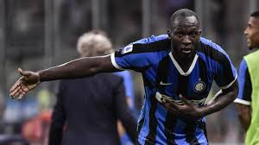
ROMELU LUKAKU(3/3)
A Belgian international, Lukaku has played 84 games for his country, and scored 52 goals, making him Belgium's all-time top goalscorer. Lukaku made his senior international debut for Belgium in 2010, at age 17, and has since represented his country at three major tournaments, including two FIFA World Cups and one UEFA European Championship. At the 2018 World Cup, Lukaku led Belgium to a third-place finish by finishing as the joint second-highest goalscorer, and won the Bronze Boot.

